Slide 1
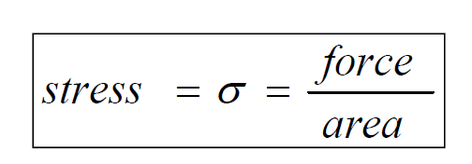
Mechanical Properties
Stress and Strain
Stress: Pressure due to applied load.
Area
tension, compression, shear, torsion, and combination.
Strain: response of the material to stress (i.e. physical
deformation such as elongation due to tension).

Slide 2
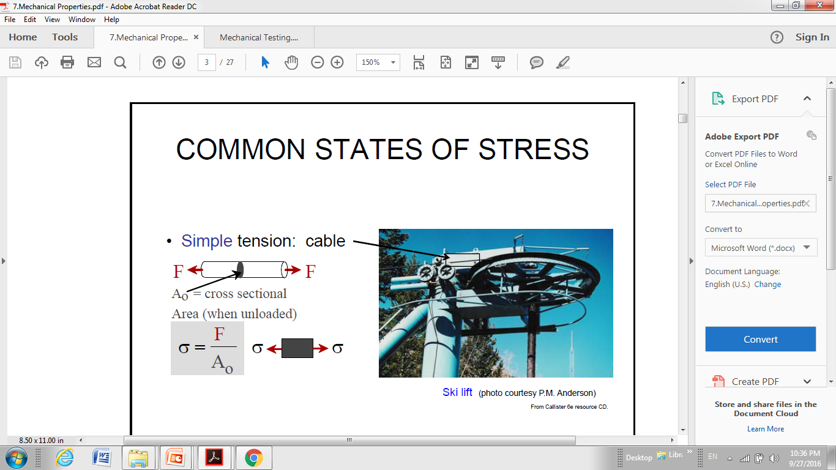

Slide 3
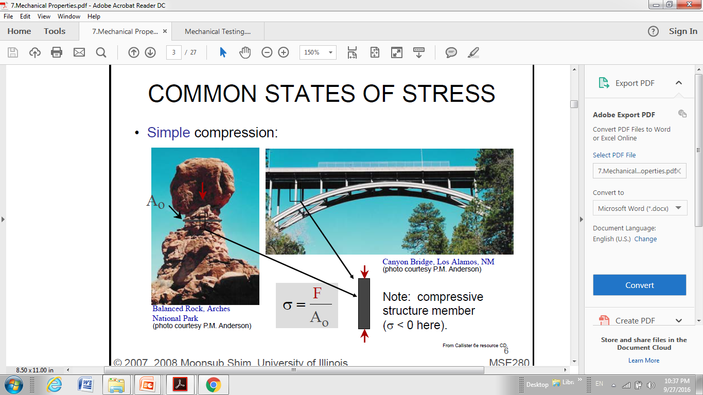
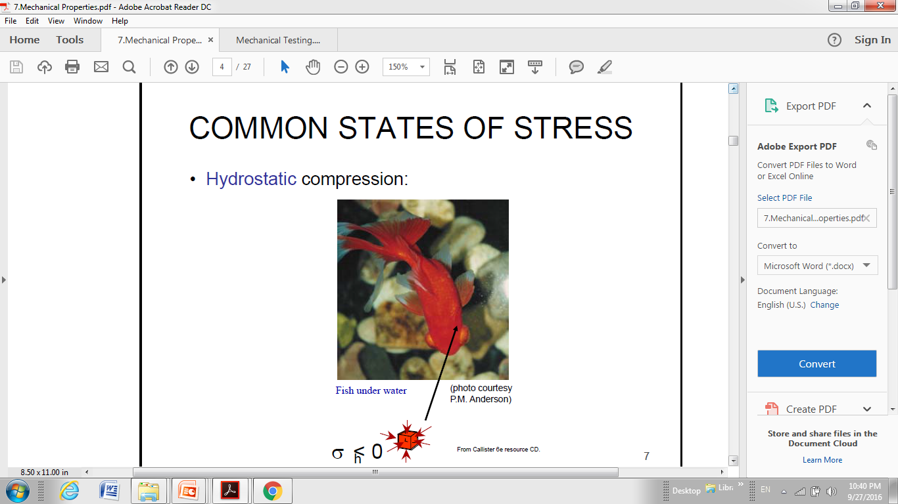

Slide 4
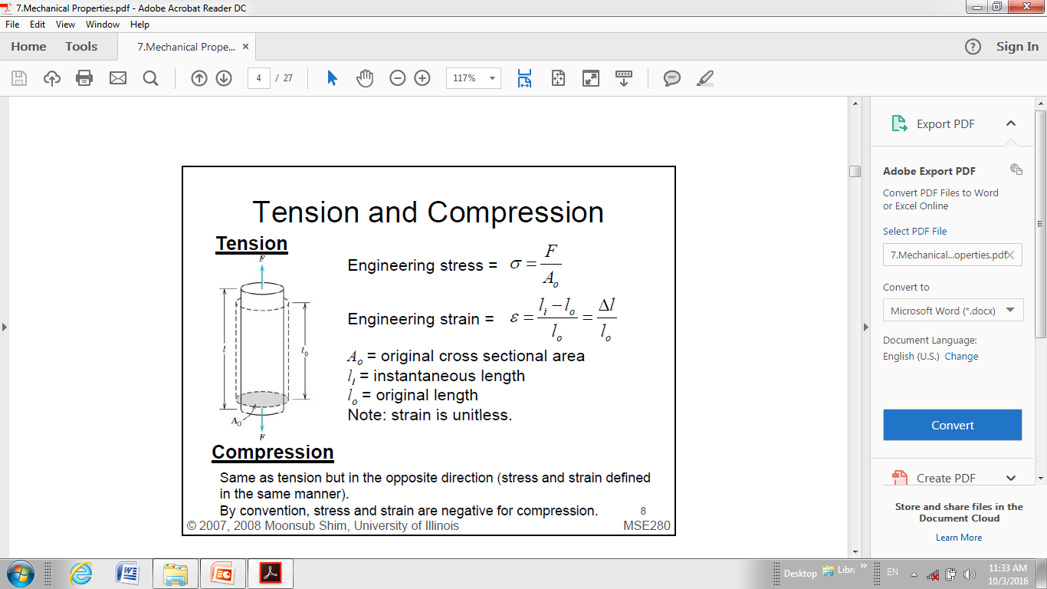
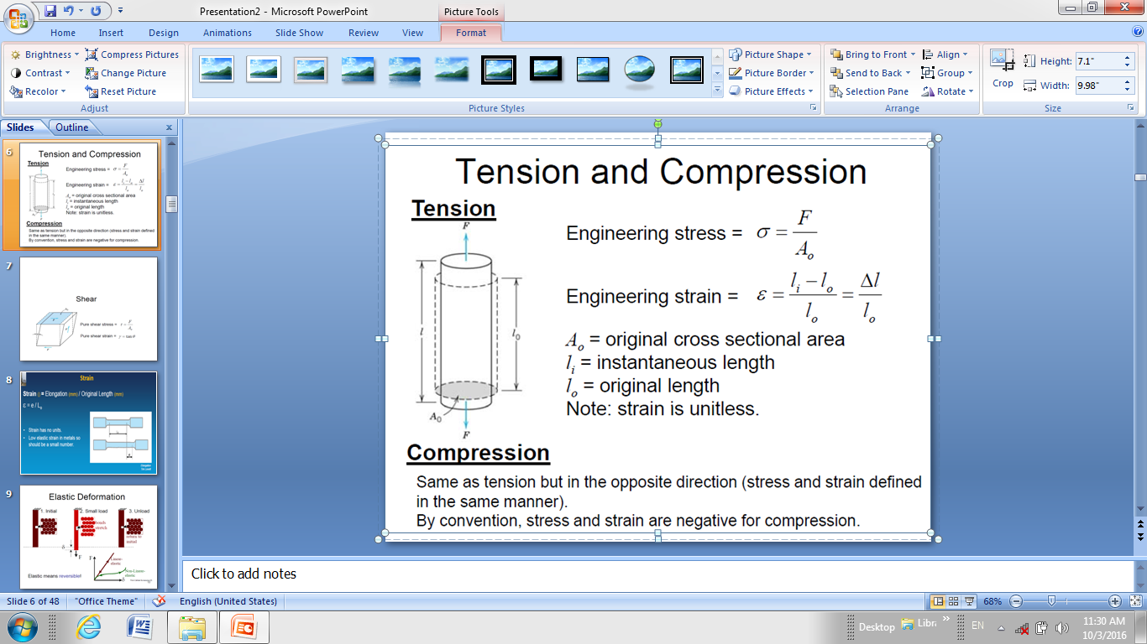
Stress has units:
SI unit: N/m² (Pa, Pascal), or N / mm² (MPa),
1 MPa = 10⁶ Pa, 1 GPa = 10⁹ Pa
US : lb/in² 1 N = 1 kg·m/s² = 0.2248 lb

Slide 5
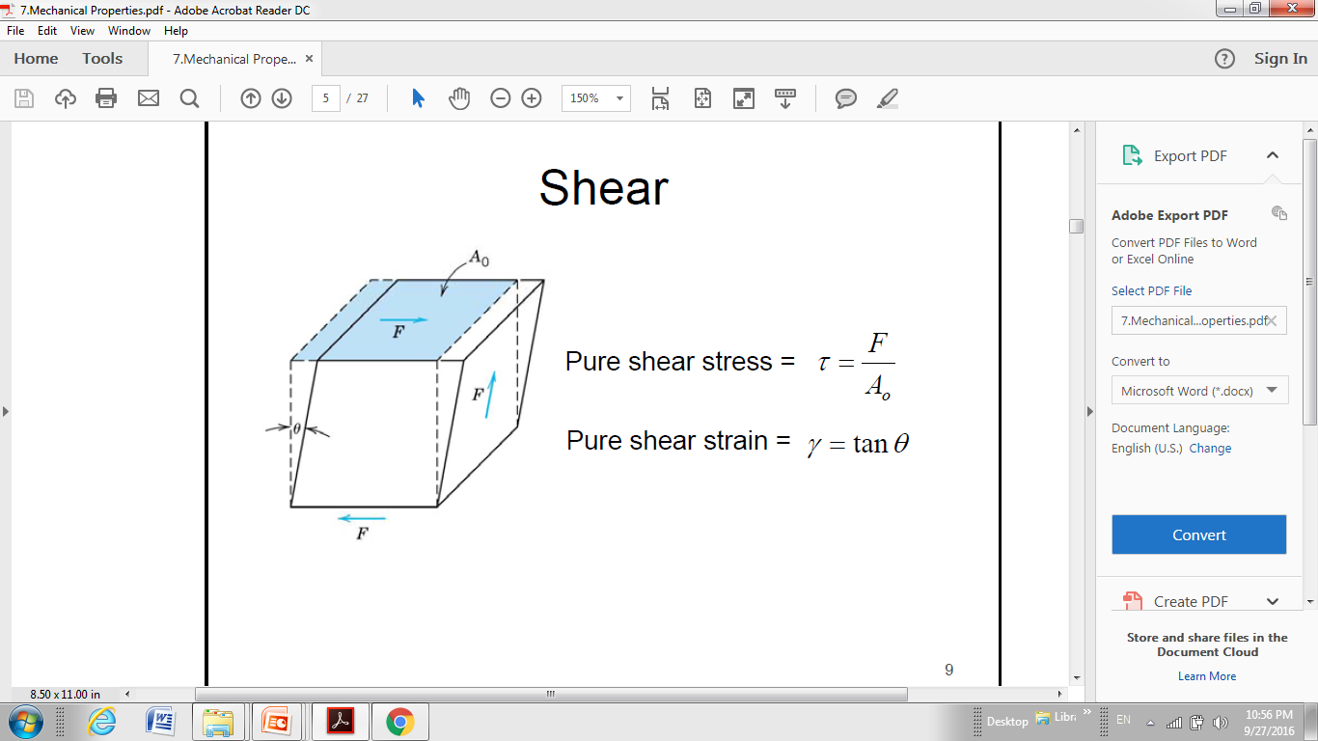
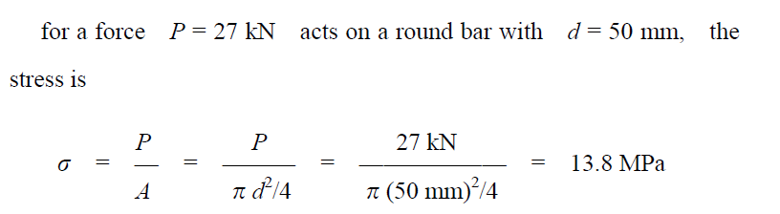

Slide 6
ENGINEERING STRESS
• Tensile stress, σ:
• Shear stress, τ:

Slide 7


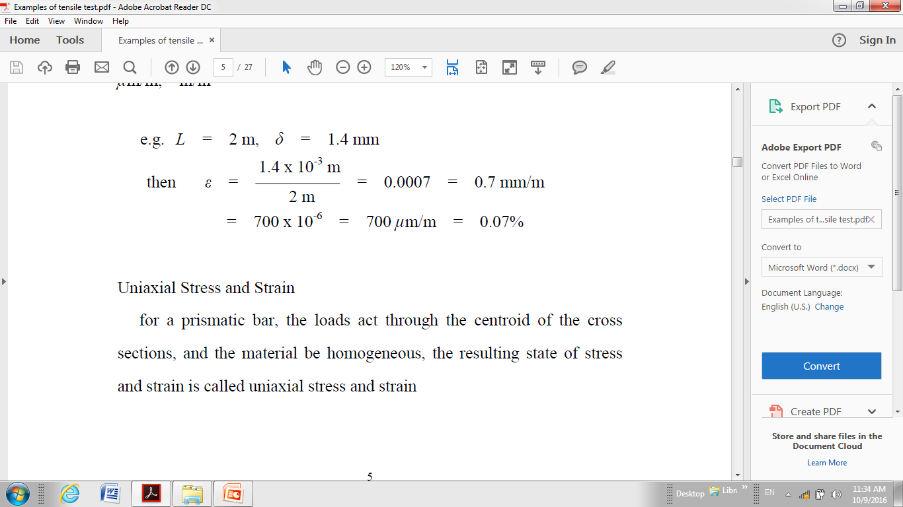
ENGINEERING STRAIN
• Tensile strain:
• Lateral strain:
δ = Δl
Strain is always
dimensionless.
• Shear strain:
e.g. l= 2m , Δl = 1.4 mm

Slide 8
ELASTIC DEFORMATION
1. Initial
2. Small load
3. Unload
Elastic means reversible!
ELASTIC DEFORMATION: is a non-permanent deformation where the material completely
recovers to its original state upon release of the applied stress.

Slide 9
PLASTIC DEFORMATION (METALS)
1. Initial
2. Small load
3. Unload
Plastic means permanent!

Slide 10
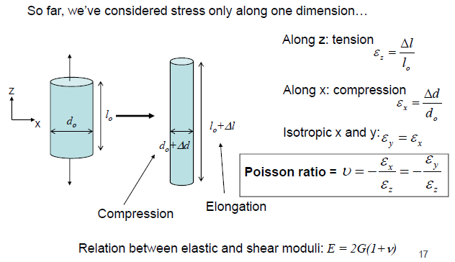
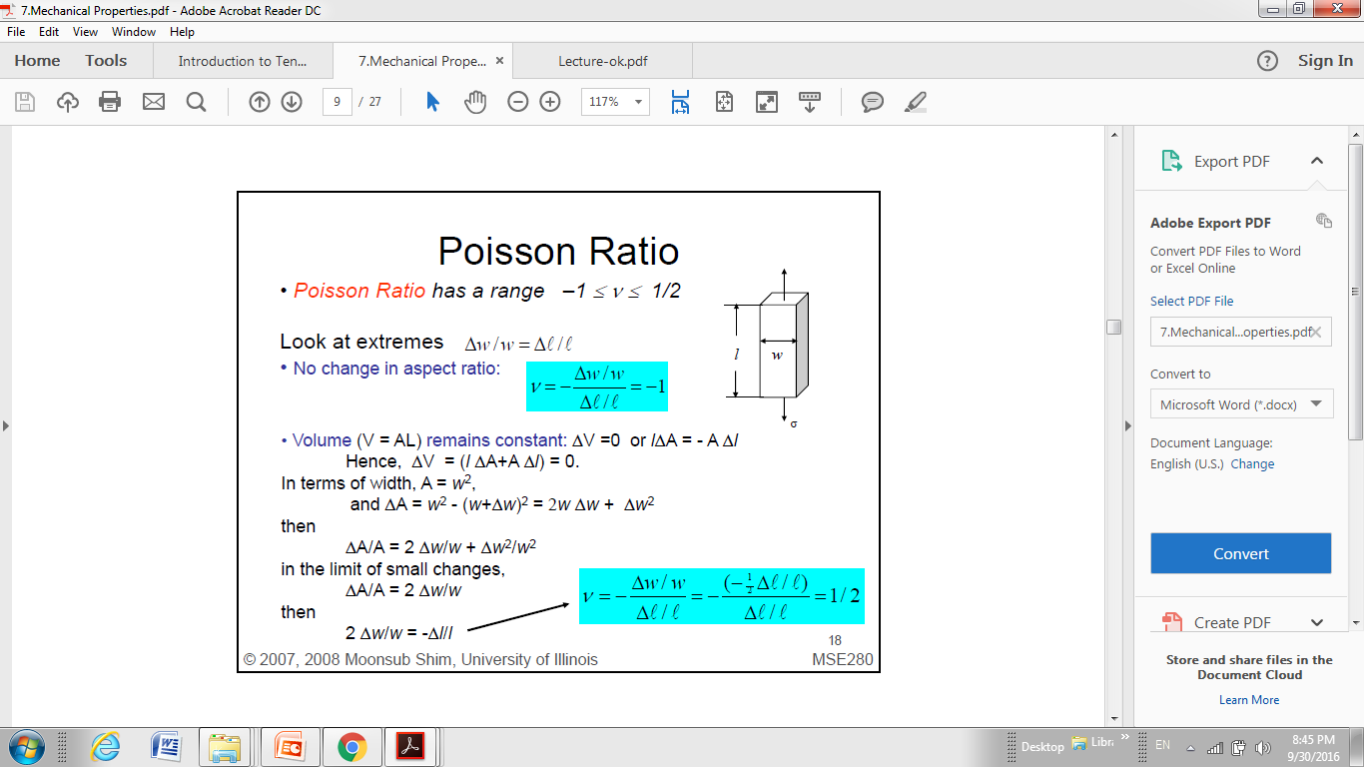
Poisson's ratio
Poisson's ratio ν is the ratio of transverse contraction strain to longitudinal extension strain in the direction of stretching force.
metals: ν ~ 0.33
ceramics: ~0.25
polymers: ~0.40
ν: dimensionless
when the properties of a material are the same in all directions, the material is said to be isotropic. So, Isotropy is uniformity in all orientations.
When the properties of a material vary with different crystallographic orientations, the material is said to be anisotropic.

Slide 11
Tensile Testing
The tensile test pulls a test-piece until it breaks.
Both force and extension are continuously measured.
Uses an extensometer to apply measured force to an test specimen. The amount of extension can be measured and graphed.
Variables such as Strain, Stress, Elasticity, Tensile strength, Ductility and Stiffness can be gauged.
Test specimens can be round or flat.
The specimen has thicker ends for attaching by grippers/thread/shoulder.

Slide 12
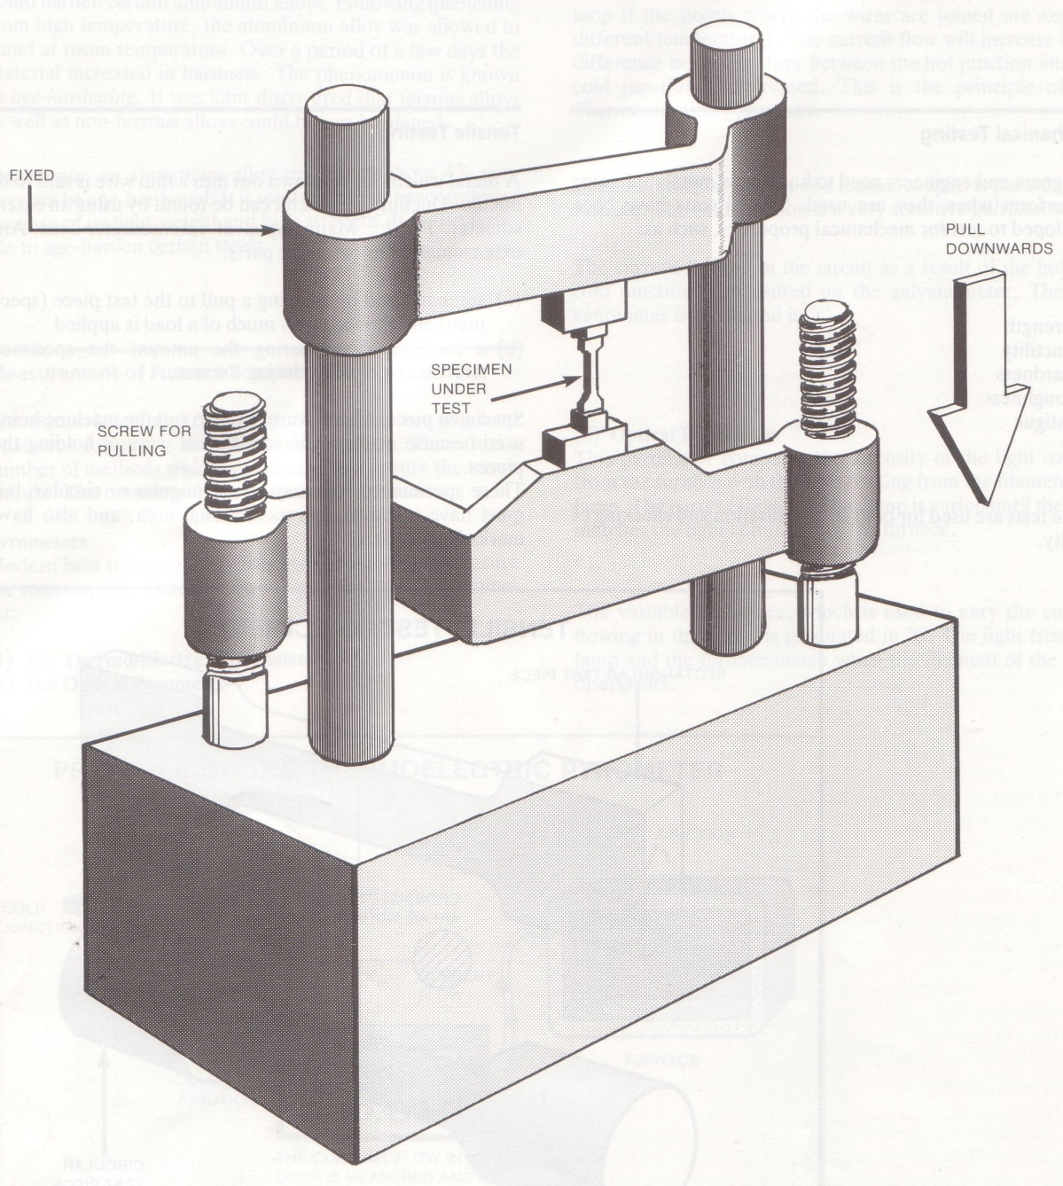
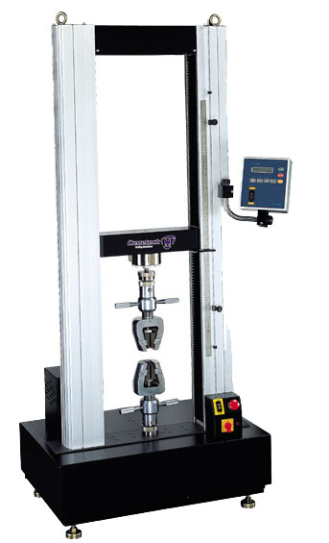
Extensometer

Slide 13
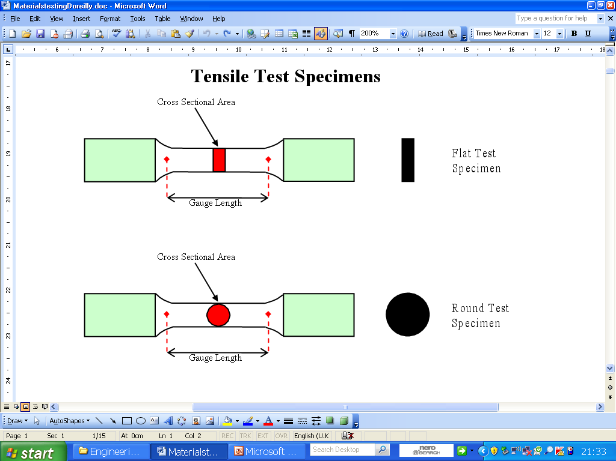
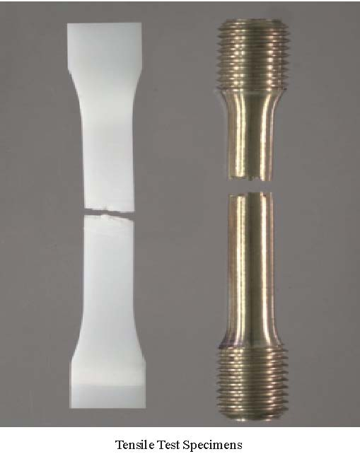
Tensile tests are usually done on prepared specimens.

Slide 14
The Test Procedure
The specimen is set up in the tensile testing machine, the extensometer.
One end is held in a vice and the other in a holding system.
A controlled load, measured in newtons (N), is applied.
The amount of stretch or extension that this force causes is measured.

Slide 15
A material that returns to its original length has elasticity. Repeated test are carried out making the load greater each time.
While the material under test has elasticity the extension or stretch is directly proportional to the load.
This is known as Hookes Law. Metals are elastic in the early stage of tensile testing, plastics are not.
σ = E ε

Slide 16
When a material fails to return to its original length it has reached its elastic limit or limit of proportionality. So elastic limit is the highest magnitude of stress for which the stress and strain are proportional to each other.
After the elastic limit the loads produce much larger extensions of the specimen. This is called the plastic region.
At the end of this stage, the extension is even greater and a yield point is reached.

Slide 17
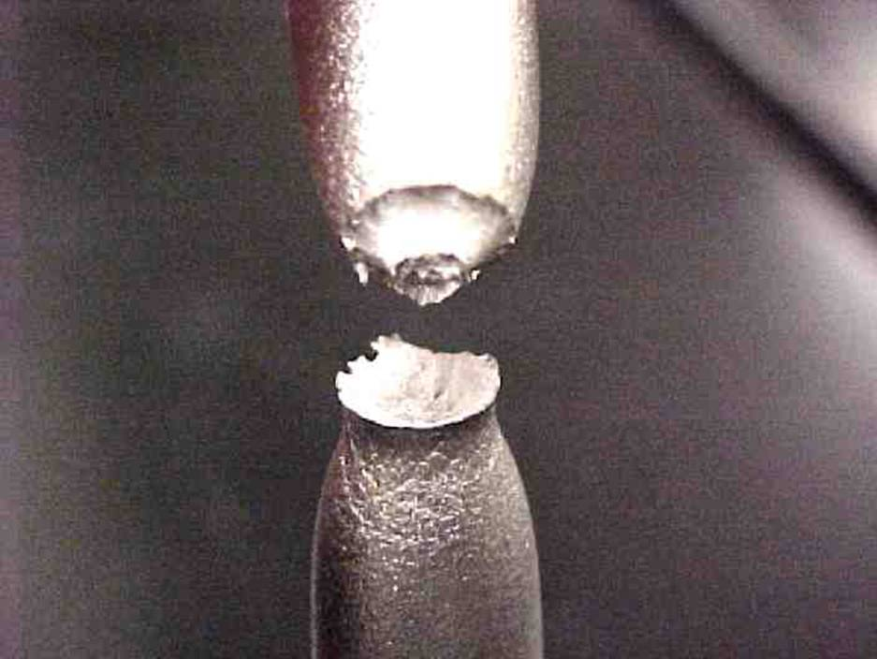
A further increase in the load causes the specimen to thin uniformly and then to neck. After necking the specimen will break or fracture.
When the fracture occurs one side of the specimen has a rough cone shape and the other has a rough cup shape. This is known as a cup and cone fracture
Producing graphs
Two basic graphs:
Load / extension graph.
Stress / strain graph.
cup and cone

Slide 18
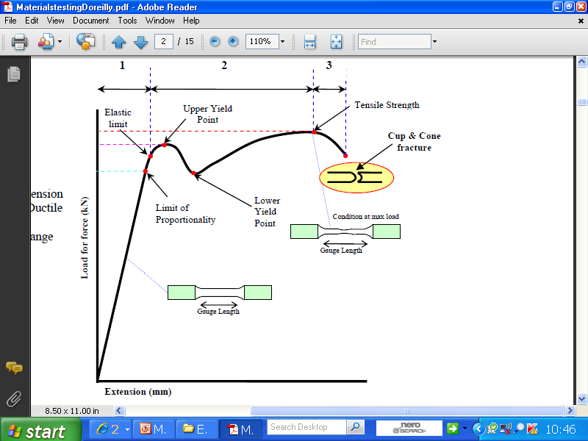
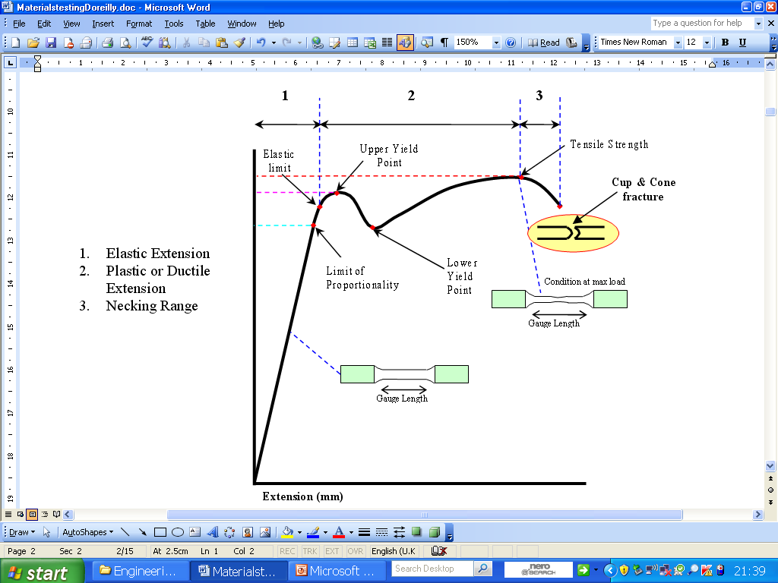
Load / extension graph.

Slide 19
